Slide 1


Minor Project 3: Search Engine Optimisation Strategy for Turbanic
Sanket Chauhan
TOPS Technologies Pvt. Ltd - Rajkot

Slide 2
INTRODUCTION
This project aims to achieve following objectives:
To create a website structure for Turbanic
To pick up one blog page & its topic, one product page, one product category page
To create the content structure for these 3 page To do detailed keyword research for each page
To list down all the important On-page elements of the 3 pages
To do a competitive analysis and tell us the top pages, to
p ranking keywords for the brand.
Write a 300-word paragraph on the blog topic that you've picked up by using keywords
INTRODUTION

Slide 3
PROBLEM STATEMENT
Turbanic is a new apparel brand that promises to provide high-quality items at reasonable pricing. By optimising their website for search engines and informing consumers about the business, the brand hopes to rank higher on search engine results pages.
The pain problems are that this brand is a startup, therefore their major objective is to raise brand awareness and gain as many consumers as possible, and because they are new to the market, their key pain point is how to rank higher on search engines when so many competitors already exist.

Slide 4
OBJECTIVES
02
Come up with the Topic Ideas
01
Create a website structure
03
Content structure
05
Keyword Research
06
On-page Elements
04
Competitive Analysis
a website structure Create a website structure eate a website structure
07
Example Blog

Slide 5
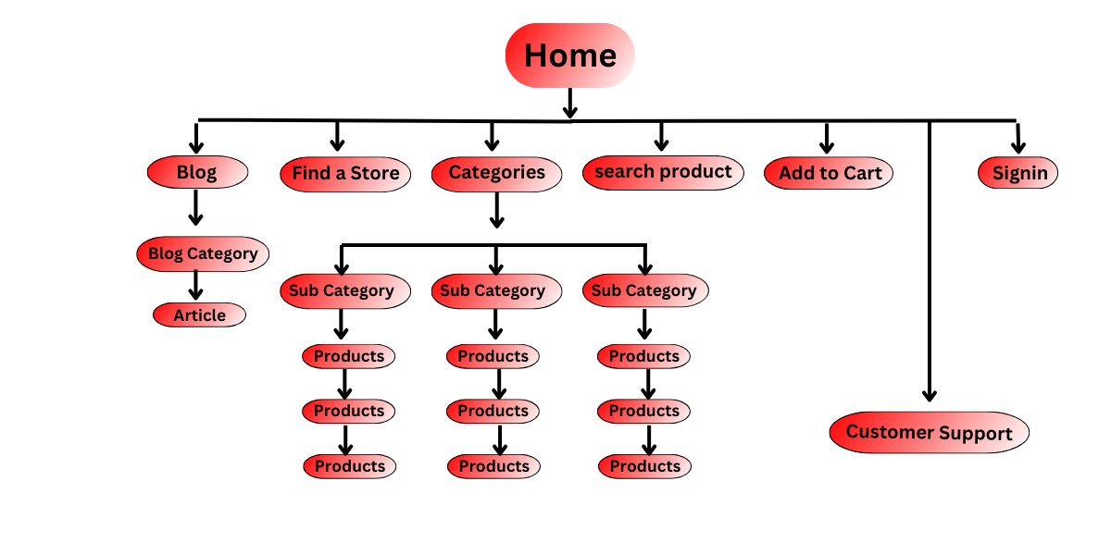
TASK 1 - CREATE A WEBSITE STRUCTURE

Slide 6
TASK 2 - TOPIC IDEAS
Girls 9-14Y
Dresses
Tops & T-Shirts
Trousers
Skirts
Shorts
Sets & Outfits
Jumpsuits & Playsuits
Sweaters & Sweatshirts
Nightwear
Underwear
Socks & Tights
Care products
BLOG TOPICS
HOW TO WEAR THE BELLABAND: OUTFIT IDEAS + TIPS
8 Modish Indian Wedding Outfits For Guests
Five Different OTPs a Turbanic Customer Should Know About
PRODUCT PAGE
NEW ARRIVALS MEN'S CLOTHES
Girls 2-8Y
Dresses
Tops & T-Shirts
Trousers
Skirts
Shorts
Sets & Outfits
Jumpsuits & Playsuits
Sweaters & Sweatshirts
Nightwear
Underwear
Socks & Tights
Care products
.
Boys 2-8Y
T-shirts & Shirts
Pants
Shorts
Sets & Outfits
Blazers & Suits
Sweaters & Sweatshirts
Sleepwear
Underwear
Socks
Swimwear
Care products
Boys 9-14Y
T-shirts & Shirts
Pants
Shorts
Sets & Outfits
Blazers & Suits
Sweaters & Sweatshirts
Sleepwear
Underwear
Socks
Swimwear
Care products
PRODUCT CATEGORY PAGE
Ladies Kids
HOME Men
Sport Sustainability
Baby Sale

Slide 7
TASK 3- CONTENT STRUCTURE
Now, come up with an idea for your website’s one blog page and its topics, one product page, and one product category page. https://docs.google.com/spreadsheets/d/1wtzBb2dC1mfSAYBqreMShizMnNfpc-cHyYA1rxufrO8/edit?usp=sharing

Slide 8
TASK 4 - COMPETITIVE ANALYSIS
Top Ranking Keywords | Volume | Position
hoodies for men | 368K | 3
bikini sets | 33.1K | 4
cargo pants for women | 90.5k | 2
hoodies for women | 165k | 5

Slide 9
TASK 5 - KEYWORD RESEARCH
Keywords | Blog Page | PRODUCT PAGE | PRODUCT CATEGORY PAGE
Primary Keyword | lehenga salwar suit sherwani | resort collar French front Blue striped | Ladies Men BabyKids Sport Sale Sustainability
Secondary Keywords | Kanjivaram saree Men’s blazers | Regular Fit Linen-blend shirt Regular-fit shirt in a cotton
Long tail Keywords | Indian wedding outfits for women Indian wedding outfits for men indian wedding guest outfit ideas 2022 Indian wedding guest outfit ideas indian wedding guest dresses indian wedding guest dresses online | open chest pocket and short sleeves Regular Fit Linen-blend shirt | Styles at irresistible prices!

Slide 10
TASK 6 - ON-PAGE ELEMENTS
On Page Elements
Title -
Meta description -
Content and Keywords -
High quality Conten -
Headers – H1,2,3,4,5,6 -
Call to Action (CTA) -
Sitemap -
Robot.txt -
Interlinking & Anchor tex -
URL structure -
Mobile responsiveness -
Website speed -
Details
Using title tag so that google can specify the title
Short page description appears under title, ideal length 155 – 160 characters
.
EAT Algorithm, using a good mix of primary, secondary, long tails keywords at right place in the content
product & service information, FAQs and USP of the product & service, trust & credUsing strong
CTA at the right places to make the lives of users easy.
create sitemap accordingly priority
added robot.txt file
Interlinking blogs & product pages to each other by using the right anchor text
Should include proper keyword. Ideally, not be more than 60-90 character
good hosting service, good site design theme, good content layout readable, very easy to navigate on mobile, mobile readiness , check using mobile friendly tool
Should be able to load quickly both on web and mobile. Ideal speed is under 2-3 seconds
ibility points
H1 & H2 most important, only one h1 and others headers according to content
TASK 6 - KEYWORD RESEARCH

Slide 11
TASK 7 - EXAMPLE-BLOG
Introduction
The pomp and grandeur of Indian weddings are unparalleled, and dressing for such events can be exciting. With a rich tapestry of cultures and traditions, the Indian subcontinent offers an array of stylish attire suitable for these occasions. From stunning lehengas to regal sherwanis, the choices are limitless. This article explores eight modern Indian wedding outfits for guests to don in 2023, helping you make a fashion statement at your next Indian wedding invitation.
Best indian wedding guest outfit ideas 2023

Slide 12
1. Lehenga: A Royal Elegance
When it comes to Indian wedding outfits for women, the lehenga stands as an epitome of elegance and opulence. It is a three-piece attire consisting of a skirt, a blouse, and a dupatta (scarf), all intricately embellished. The lehenga is often the go-to choice for women seeking an outfit that combines tradition with modernity. The latest designs in 2023 have seen a surge of contemporary elements, like cape-style blouses and high-low hemlines, making them an ideal Indian wedding guest outfit idea.
2. Salwar Suit: Comfort with a Dash of GlamourA salwar suit is another excellent option for Indian wedding guest dresses. These suits perfectly blend comfort and style, catering to various tastes. The current trend is leaning towards palazzo and sharara style suits, featuring vibrant colours and elaborate embroidery. Plus, with the convenience of Indian wedding guest dresses online, finding a salwar suit that matches your style has never been easier.
3. Sherwani: A Regal Statement
Moving onto Indian wedding outfits for men, the sherwani holds a place of prominence. This long, coat-like garment, usually paired with a churidar or dhoti, is a classic choice for a traditional yet stylish look. With an array of designs and fabrics, from silk to velvet, sherwanis exude a regal charm that is hard to resist. This is one of the best Indian wedding outfits for men.

Slide 13
4. Kanjivaram Saree: Timeless Beauty
No list of Indian wedding outfits would be complete without mentioning the Kanjivaram saree. Originating from Kanchipuram in Tamil Nadu, these sarees are renowned for their rich textures, vibrant colours, and exquisite gold-dipped silver threadwork. They are a timeless addition to your Indian wedding guest outfit ideas.
5. Men's Blazers: Western Touch to the Traditional Affair
For men preferring a Western touch, blazers can be an ideal choice. They are versatile pieces styled with a pair of trousers or even traditional dhoti pants. The key is to choose a blazer with a bit of flair - think vibrant colours or patterns, making it a fantastic addition to Indian wedding guest outfit ideas for 2023.
6. Anarkali Suits: The Flair of Royalty
Anarkali suits, known for their distinctive frock-style top and slim fitted bottom, add a royal touch to Indian wedding guest dresses. They are perfect for those seeking a majestic yet comfortable outfit. The flowy silhouette is both flattering and stylish, suitable for any wedding event.
Notes:
6. Anarkali Suits: The Flair of Royalty
Anarkali suits, known for their distinctive frock-style top and slim fitted bottom, add a royal touch to Indian wedding guest dresses. They are perfect for those seeking a majestic yet comfortable outfit. The flowy silhouette is both flattering and stylish, suitable for any wedding event.

Slide 14
7. Indo-Western Gowns: Fusion at Its Best
Indo-western gowns are a trendy choice, especially for younger guests. They blend Western cuts and silhouettes with traditional Indian designs and embellishments, resulting in a stunning fusion outfit. It's an innovative Indian wedding guest outfit idea that's gaining popularity.
8. Bandhgala: Classic Sophistication
Lastly, for men, the Bandhgala is a classic Indian outfit that exudes sophistication. It's a formal suit-like attire, typically made from luxurious fabrics like silk or brocade. With its neat, tailored fit, the Bandhgala makes a strong statement at any Indian wedding.
Conclusion
Dressing for an Indian wedding is all about embracing vibrant colours, intricate designs, and the festive spirit of the occasion. Whether you choose the elegance of a lehenga, the comfort of a salwar suit, or the sophistication of a Bandhgala, your outfit should reflect your personal style and the joy of the celebration. With these eight outfit ideas, you'll not only blend seamlessly into the festivities but also stand out with your unique style statement.

Slide 15
EXAMPLE BLOG (on-page elements)
On Page Elements
Title -
Meta description -
Headers – H1,2,3,4,5, -
Content and Keywords -
(High quality Content)
Images -
Interlinking & Anchor tex -
UI/UX -
URL structure -
Mobile responsiveness -
Website speed -
Best indian wedding guest outfit ideas 2023
Explore the eight most trendy Indian wedding outfits for guests in 2023. From traditional lehengas to chic Indo-Western gowns, discover the perfect attire
Short page description appears under title, ideal length 155 – 160 characters
EAT Algorithm, using a good mix of primary, secondary, long tails keywords at right place in the content , refer task
Proper Image Alt Text, file name, size should be maintained, image related to content
Interlinking blogs & product pages to each other by using the right anchor tex
Headers, footers, features, look & feel – all this can be checked by doing proper competitor analysis.
Should include proper keyword. Ideally, not be more than 60-90 characters Home/blog/blog category/Make yourself a hot cup of “CHAI”
good hosting service, good site design theme, good content layout readable, very easy to navigate on mobile, mobile readiness , check using mobile friendly tools
Should be able to load quickly both on web and mobile. Ideal speed is under 2-3 seconds.

Slide 16
CONCLUSION
To sum it up, Turbanic needs a killer SEO plan to make a name for itself online, attract more visitors to its site, and turn them into loyal customers. You can improve the website's position in search engine results by using on-page and off-page optimisation techniques. This will give your clothing company an advantage in the competitive market.
To get more people to visit Turbanic's website, they should focus on improving it. This means using the right words on the site, making the content enjoyable and easy to read and finding things on the site. Doing these things will help Turbanic get more clicks, keep people on the site longer, and eventually get a higher ranking on search engines. To improve its online presence, the company should also work on getting links from reliable sources, using social media effectively, and teaming up with influencers.

Slide 17
To attract more customers to its physical store, Turbanic should prioritise local SEO. This means targeting people in the nearby area who are looking for products like theirs. In addition, to keep up with the ever-changing search engine algorithms and maintain its search rankings, it's vital for a website to monitor its SEO progress regularly, make updates as needed, and stay up-to-date on the latest industry trends.
Turbanic can increase its online visibility, establish brand credibility, and boost sales and revenue in the competitive clothing market by following these essential steps for a building comprehensive SEO strategy.

